Slide 1
People Development: A priority for the Tourism Sector
Presentation at the
Local Government Tourism Conference
30-31 March 2015

Slide 3
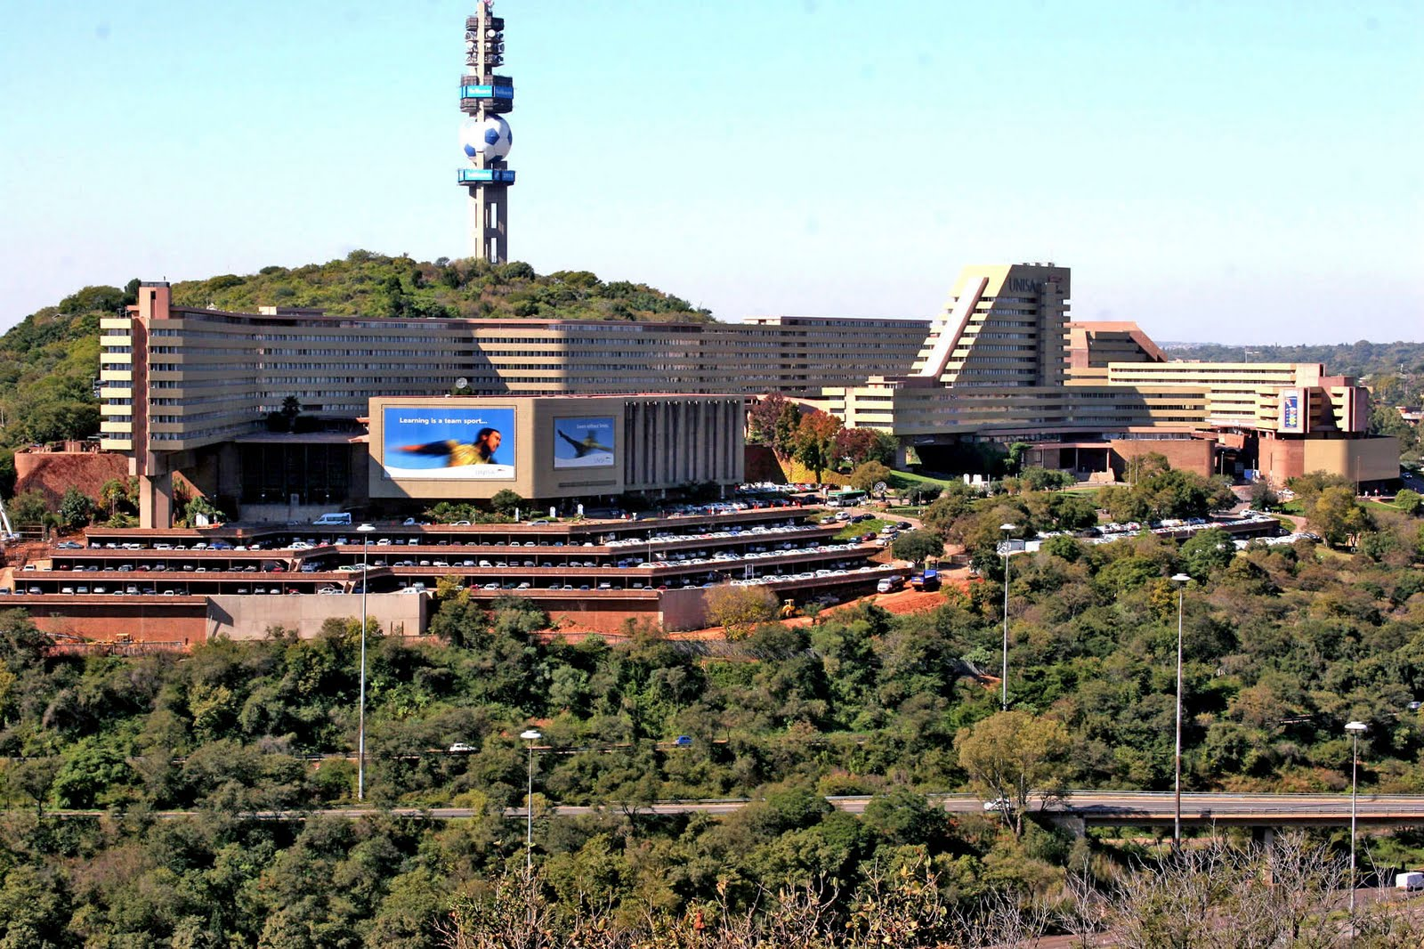
Content
Why is people development a priority for the tourism sector?
What are the potential opportunities?
Tourism Programme Qualification Mix.
Potential challenges to people development?
Incentives for excellent people development.
Dr Nellie Swart, CMP

Slide 4
Why is people development a priority for the tourism sector?
1 out of 7 people in the world travelled in 2014 (UNWTO, 2015).
1 in every 11 jobs are related to tourism (WTTC, 2015).
Human resources challenge: 14 million jobs at risk (WTTC, 2015).
Objectives of the NTSS (2011) and Domestic Tourism Growth Strategy (2012)
Notes:
Transformation
Decent work
Service excellence
Community beneficiation

Slide 5
What are the potential opportunities?
Tourism empower communities (WTTC, 2015).
People need to understand that tourism is a viable career.
Annual 6.5% growth in secondary school tourism numbers (116 000 students in 2014 → 25% of schools) (Weston, 2015).
Further education and training is available to become more qualified in the field of tourism.
Assist in the formulation of a people development and tourism awareness strategy (NTSS, 2011)
Future research projects.

Slide 6
Tourism Programme Qualification Mix
An example

Slide 7
NQF Level | Vocational Qualification Stream | Career-focused Qualification Stream | General Formative Qualification Stream
10
9
8
7
6
5
Entry
PhD / DCom (Tourism Management)
M.Com (Tourism Management)
Conditions
B.Com Hons (Touirsm Management)
(120 Credits)
Postgraduate Diploma in Tourism Management (120 credits)
Adv Diploma in Tourism Management (120 Credits)
B.Com Tourism Management (360 Credits)
Diploma in Tourism Management (360 Credits)
Higher Certificate in Tourism Management (120 Credits)
National Senior Certificate (Diploma endorsed) & (achievement rating of 4 or better*)
National Senior Certificate

Slide 8
INTRODUCTION TO TOURISM
THE HISTORY OF TOURISM
DEMAND FOR TOURISM
(Tourist generating region)
Tourist motivation
Tourist markets
SECONDARY FACTORS
CONNECTING SUPPLY AND DEMAND
(Traveller generating region)
Tourist transportation management
Tourism marketing
Tourism distribution
PRIMARY FACTORS
SUPPLY OF TOURISM
(Destination region)
Tourist destinations
Hospitality
Tourist attraction management
Tourist transportation management
TOURISM ENABLERS
The management of tourism
Tourism planning and development
Sustainable tourism
Tourism policy and organisation
THE FUTURE OF TOURISM
Source: UNISA TRT1502, 2015

Slide 9
Potential challenges to people development?
Effectiveness of CATHSSETA (NTSS, 2011) / NSFAS
Grade 12 Tourism is not a university designated subject.
Creating a sustainable resource base for Work Integrated Learning (WIL) (Groenewald & Thulukanam, 2005).
Perception of diplomas vs degrees in tourism.
School leavers’ perception of a career in the tourism industry.
The gap between high school and post school education
Recognition for prior learning
Tourism as a niche / specialist area.

Slide 10
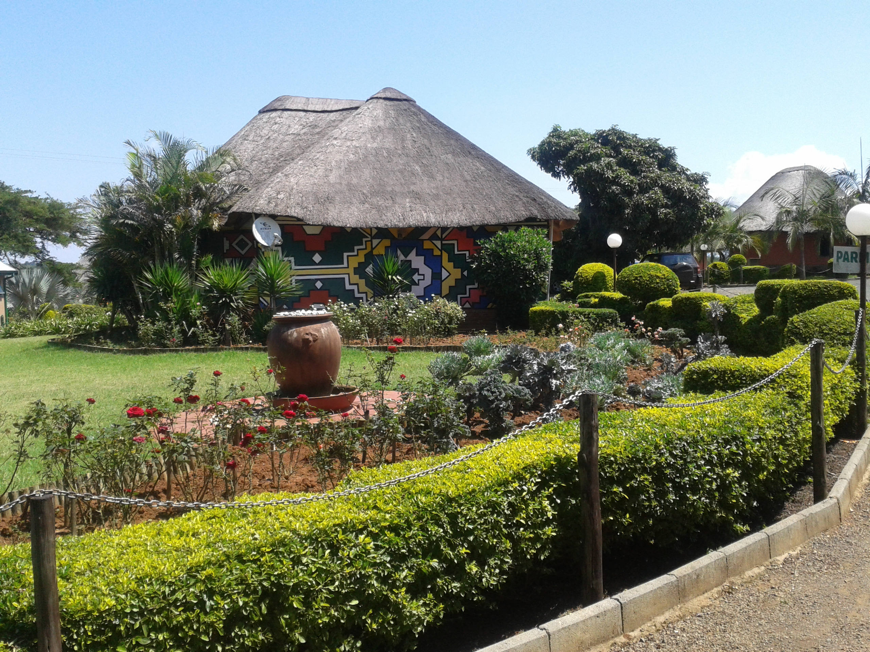
Incentives for excellent people development

Slide 11
Dr Nellie Swart, CMP
Senior Lecturer
Department of Transport Economics, Logistics and Tourism
E-mail: swartmp@unisa.ac.za
Twitter: @swartnellie

